Slide 1
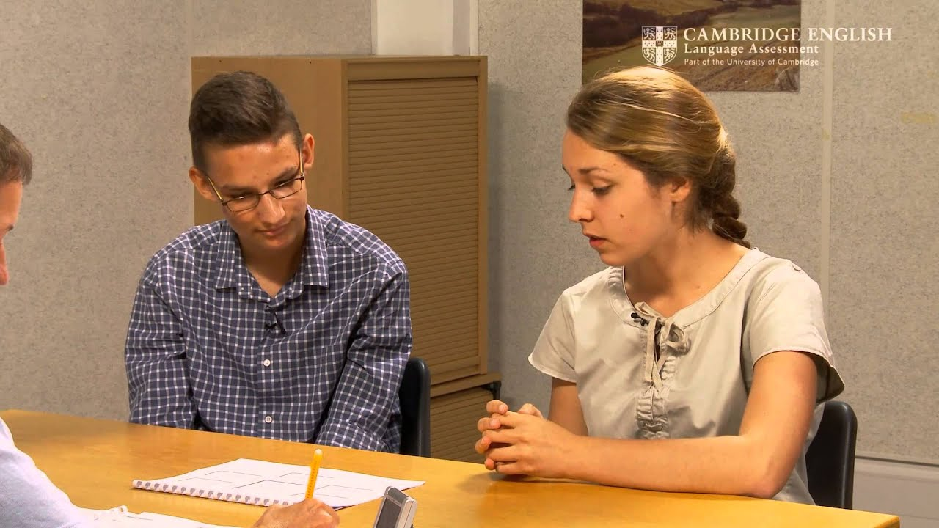
Speaking Exam

Slide 2
B2 First
Four tasks

Slide 3
B2 First
Four tasks:
Short conversation
One-minute long turn
Two-way conversation
A discussion

Slide 4
B2 First
Short conversation 2 mins
One-minute long turn 4 mins
Two-way conversation 4 mins
A discussion 4 mins
Total: 14 mins

Slide 5
Part 1 – short conversation
Personal Questions:

Slide 6
Part 1 – short conversation
Personal Questions:
Where are you from?
What do you do in your free time?
How long have you been learning English?

Slide 7
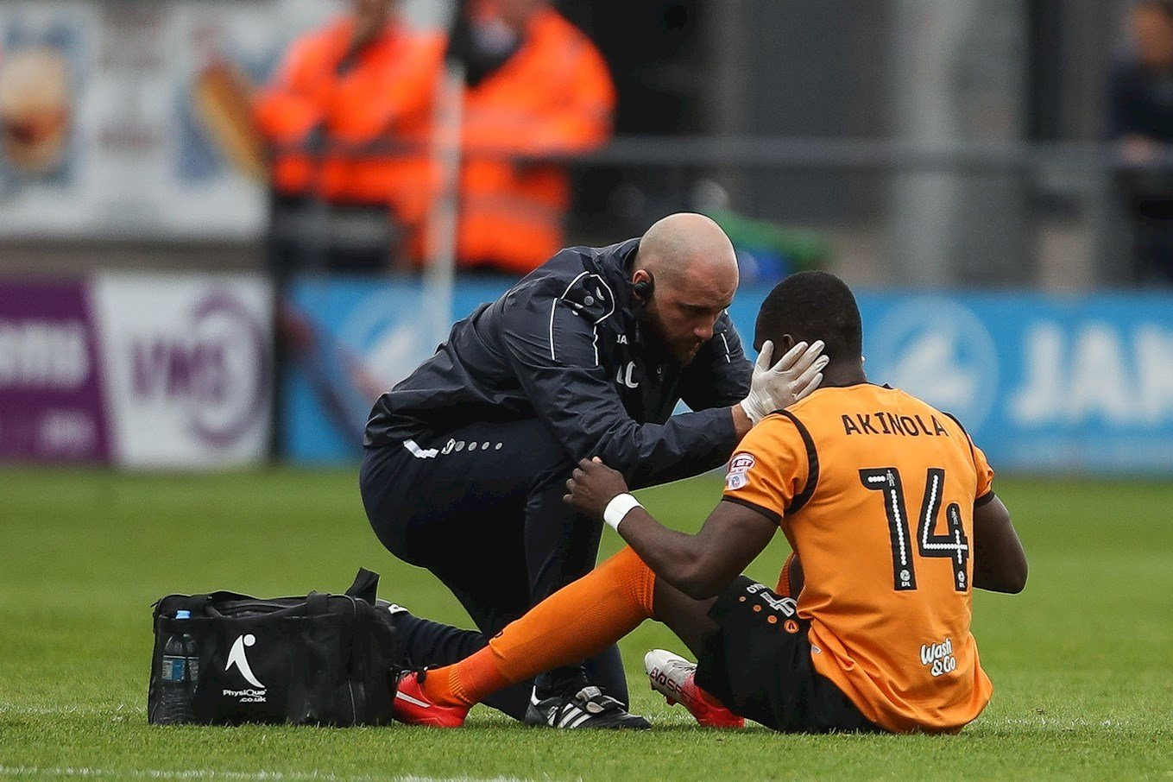
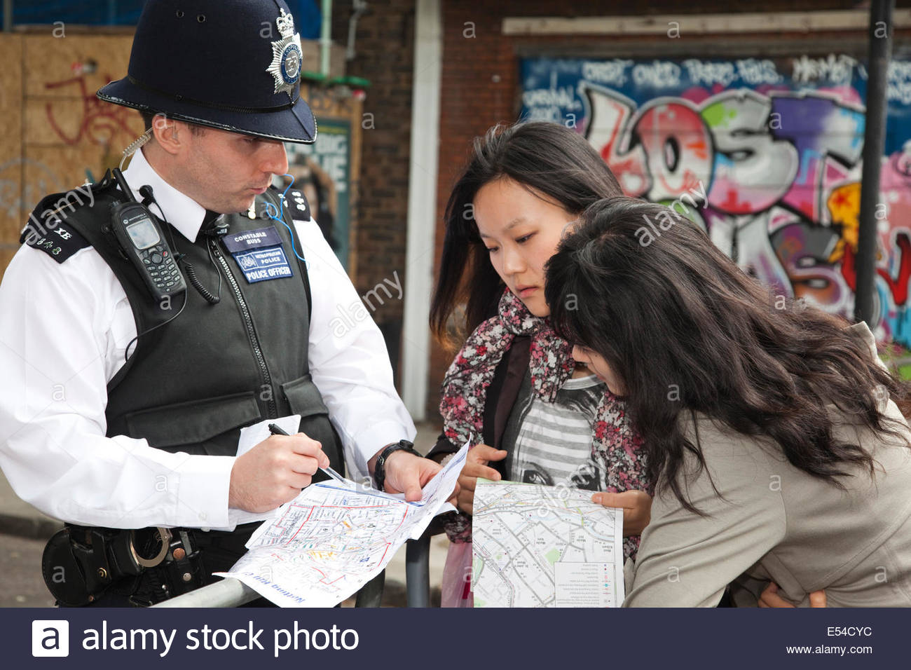
How important is it to help people in these situations?

Slide 8
Speaking Part 3
Why would these ideas attract more tourists to the town?
building a large nightclub
putting up security cameras
building holiday flats
providing parks
having more shops

Slide 9
Speaking Task 4
A discussion on topics related to Task 3

Slide 10
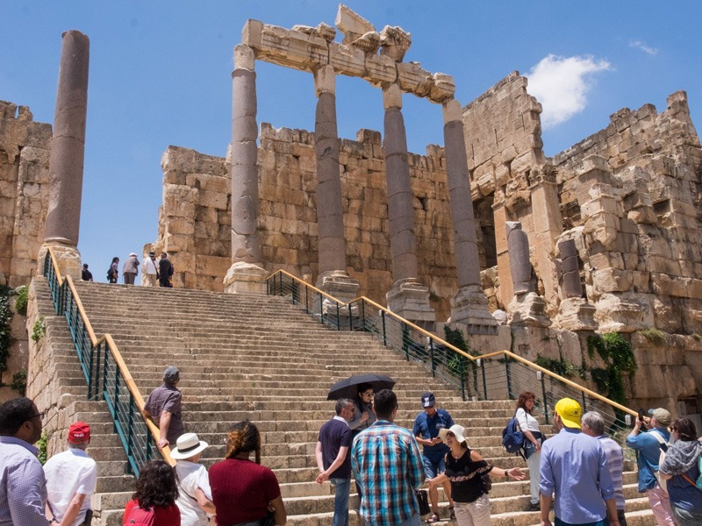
General questions about tourism

Slide 11
General questions about tourism
Why do people like to travel to different places in their free time?
What kind of places do tourists who visit your country like to visit?
Is it better to go on holiday in your own country or a foreign country?

Slide 12
Speaking Exam
Assessing Speaking Performance:

Slide 13
Speaking Exam
Assessing Speaking Performance:
Grammar and vocabulary
Discourse management
Pronunciation
Interactive Communication

Slide 14
Speaking Exam
Grammar and vocabulary 0-5
Discourse management 0-5
Pronunciation 0-5
Interactive Communication 0-5

Slide 15
Speaking Exam
Grammar and vocabulary 0-5
Discourse management 0-5
Pronunciation 0-5
Interactive Communication 0-5
Total marks: 20
Pass mark: 12/20 (60%)

Slide 16
Speaking Exam
What is Grammar and vocabulary?

Slide 17
Speaking Exam
What is Grammar and vocabulary?
Range and level of your grammar and vocabulary
Accuracy / mistakes

Slide 18
Speaking Exam
What is discourse management?

Slide 19
Speaking Exam
What is discourse management?
Do you answer the question?
Are your answers long or short?
Do you hesitate?
Do you organise your language (by using discourse markers and cohesive devices)

Slide 20
Speaking Exam
Discourse markers are words and phrases such as ‘you know’, ‘I mean’, ‘anyway’
Cohesive devices are linking words such as ‘however’, ‘on the one hand’, ‘in addition’, ‘firstly’, etc.

Slide 21
Speaking Exam
What is pronunciation?

Slide 22
Speaking Exam
What is pronunciation?
Can the examiners understand you?
Do you use correct intonation?
Do you stress the correct words and syllables?
Can you make the individual sounds?

Slide 23
Speaking Exam
What is interactive communication?

Slide 24
Speaking Exam
What is interactive communication?
Do you work with your partner well?
Do you ask for his/her opinion?
Do you answer when he/she asks for your opinion?

Slide 25
Speaking Exam
What is interactive communication?
Do you work together to develop the conversation?
Do you work together to answer the question?

